Slide 1
Programming for Image Processing/Analysis and Visualization using
The Visualization Toolkit
Week 7: Miscelleneous Topics
http://noodle.med.yale.edu/~papad/seminar/
Man Pages etc: http://noodle.med.yale.edu/tcl
and http://noodle.med.yale.edu/vtk/
Xenios Papademetris
papad@noodle.med.yale.edu
BML 325, 5-7294

Slide 2
Revised Schedule for Part 1
Introduce VTK (9/3)
Introduce Tcl/Tk(9/10)
Simple Visualization Tasks (9/17)
Surface and Image Manipulation (9/23)
Image Manipulation and Display(10/1)
Marcel: Graphical User Interfaces (10/15)
Miscellaneous Topics (11/5)
Local Extensions (11/12)

Slide 3
Revision -- VTK Pipeline (I)
File Output
Sources
Filters
Mappers
Props
vtkDataSet
vtkDataSet

Slide 4
Data Representation
(vtkDataSet)
Point Attributes
(vtkPointData)
Point Properties
(e.g. intensity)
Points
(vtkPoints)
Define Location
Arrays of
Numbers
(one per point
or cell)
vtkDataArray
Data Set
Cells
(vtkCellArray)
Define Topology
Cell Attributes
(vtkCellData)
Cell Properties
(e.g. normal)

Slide 5
Images are Simpler
Point Attributes
(vtkPointData)
Point Properties
(e.g. intensity)
Points
(vtkPoints)
Define Location
Arrays of
Numbers
(one per point
or cell)
vtkDataArray
vtkImageData
Cells
(vtkCellArray)
Define Topology
Cell Attributes
(vtkCellData)
Cell Properties
(e.g. normal)
Implicitly Defined by Image Specification
Rarely Used

Slide 6
vtkImageData
vtkImageData is the basic VTK class for storing images.
It is defined by 4 key elements
  Dimensions -- these define the size of the image
  Origin -- the position in 3D space of point 0 0 0
  Spacing -- the voxel dimensions
  Scalar Type -- the type of the image (e.g. float, short etc)
An 4x4x4 image has 4x4x4=64 points and 3x3x3=27 cubic cells (both are implicitly defined)

Slide 7
Creating an Image
# Create the Structure
vtkImageData img
# Set Dimensions
img SetDimensions 10 10 2
# 3D Coordinates of Bottom Left Voxel
img SetOrigin 0 0 0
# Voxel Size
img SetSpacing 0.78 0.78 1.5
#Image Type
img SetScalarTypeToShort
#Number of Components (or frames for timeseries)
img SetNumberOfScalarComponents 1
#Allocate the Memory
img AllocateScalars

Slide 8
Manipulating An Image with TCL
Some operations require pointers and require the use of C++. We focus here on those operations that are accessible at the scripting level.
The dimensions/spacing/origin of the image are accessible via
set dim [ img GetDimensions ]
set sp [ img GetSpacing ]
set ori [ img GetOrigin ]
dim,sp and ori a tcl lists of length 3. To access individual elements we use the lindex command I,e,
set numslices [ lindex $dim 2 ]
Set voxelwidth [ lindex $sp 0 ]
Set voxelheight [ lindex $sp 1 ]
set slicethickness [ lindex $sp 2 ]
(Strictly speaking this value should be the distance between slice centers and not the slice thickness)
Data is stored in an one-dimensional array. To find the index in that array of a voxel (i,j,k)
set index [ img ComputePointId $i $j $k ]

Slide 9
Accessing the Intensity Array
The intensities of the image are stored in the Scalars member of
the PointData of the image. This is a DataArray of the appropriate
type. To get a pointer to this array use
set data [[ img GetPointData ] GetScalars ]
Then given the index of a given point (i,j,k) we can set/get the voxel
Intensity value using
set v [ $data GetComponent $index 0 ]
Or more directly
set v [ img GetScalarComponentAsFloat $i $j $k 0 ]
Where index is the voxel id (obtained using ComputePointId)
and 0 is the frame/component number. We can set the
intensity to 123 using
$data SetComponent $index 123
Unfortunately there is no direct method for setting.

Slide 10
Manipulating the Intensity Array
To Fill a particular component with a particular value use
set data [[ img GetPointData ] GetScalars ]
$data FillComponent 0 0
To get the range of values in a particular component use
set range [ $data GetRange ]
set minimum [ lindex $range 0 ]
set maximum [ lindex $range 1 ]
To get the maximum/minimum values allowed in the array use:
set max [ $data GetDataTypeMax ]
set max [ $data GetDataTypeMin ]

Slide 11
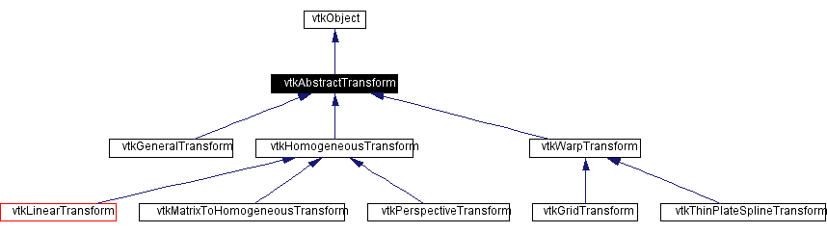
Transformations

Slide 12
Transformations
Five major transformation types:
  vtkTransform represents a 4x4 linear transformation. It also allows for the concatenation of different linear operations such as translations, rotations, scales, multiplication with a 4x4 matrix etc.
  vtkGridTransform represents a transformation as a vector field
  vtkThinPlateSplineTransform represents the transformation as a mapping between two sets of corresponding points and a suitably defined interpolation kernel
  vtkGeneralTransform allows for the concatenation of different types of transformations to form a single composite
  vtkLandmarkTransform allows for the computation of best least squares rigid,similarity or affine transformations given two sets of corresponding points. (These are represented as 4x4 matrices)

Slide 13
Concatenation
Key item to remember is that VTK uses a pre-multiply scheme by default i.e. A concatenated with B means [A]*[B] not the more conventional [B]*[A]
This behavior can be rectified in vtkTransform and vtkGeneralTransform using the PostMultiply method
All transformations support the TransformPoint method and the Identity Method.

Slide 14
Transforming a Surface
Given a surface poly we can translate it by (10,5,0) using
vtkTransform tr
tr Translate 10 5 0
vtkTransformPolyDataFilter tf
tf SetInput poly
tf SetTransform tr
tf Update
This will operate using transformation tr on each point.

Slide 15
Transforming a Surface II
We can create a transformation that first translates by (10,5,0), then rotates by 20˚ about the Z-axis and finally magnifies the object by a factor of 2 as:
vtkTransform tr
tr PostMultiply
tr Translate 10 5 0
tr RotateZ 20
tr Scale 2 2 2

Slide 16
Explicit 4x4 Matrix Definition
We can explicitly specify an arbitrary 4x4 matrix transformation using vtkMatrix4x4 (in this case we specify a translation of (10,0,0))
vtkMatrix4x4 mat
mat Identity
mat SetElement 0 3 10.0
vtkTransform tr
tr SetMatrix mat
mat Delete

Slide 17
Reslicing an Image
F
r’
r
Reference Image R
(Static)
Transform Image T
(Moving)
In reslicing images we compute a transformation T which maps positions on the reference image to positions in the transform image. (e.g r’=F*r)
The standard image reslicing algorithms (vtkImageReslice) then takes the intensity at r’ T(r’) and places it at position r in the new resampled image.
Hence while F maps points from R to T, it maps intensities from T to R!!

Slide 18
vtkImageReslice
vtkImageReslice is one of the most powerful classes in VTK.
It can be used to reslice, resample and reorient images using different transformations and interpolation strategies.
In its simplest complete usage it takes a number of parameters the most useful being:
  The input image T to be resliced
  The information input image R that defines the output geometry [ Note that the output geometry can also be defined explicitly without using an information input ]
  The reslice transformation that maps R to T [ identity if not specified ]
  The interpolation strategy used to interpolate T (nearestneighbor, linear, cubic)

Slide 19
An Example Using a GUI examples\example6_1.tcl
In previous examples we used vtkRenderWindow and vtkImageViewer as the final output window on the display. These are separate from the rest of the GUI and to make more integrated applications vtk supplies
  vtkTkImageViewerWidget -- a Tk widget that contains a vtkImageViewer
  vtkTkRenderWindowWidget -- a Tk widget that contains a vtkRenderWindow
These widgets can be used to embed vtk windows into a Tk-based graphical user interface
The underlying vtkImageViewer and vtkRenderWindow are accessed using the GetImageViewer and GetRenderWindow methods respectively.

Slide 20
Image Reslice Example – the GUI
# Set The Window Size to 400 x 250
wm geometry . 400x250
# Create Two frames, .top and .bottom and pack them
frame .top ; frame .bottom
pack .bottom -side bottom -expand false -fill x -pady 2 -padx 20
pack .top -side top -expand true -fill both
# Add an exit button to the bottom frame and pack it
button .bottom.exit -text "Exit!" -command { destroy . ; exit }
pack .bottom.exit -side left
# Create two frames in the top frame called .left and .right
frame .top.left -bg green -height 200; frame .top.right -bg red -height 200
pack .top.left .top.right -side left -expand true -fill both -padx 2
# Add labels to left and right to label the images to be displayed!
label .top.left.lab -text "Original"
pack .top.left.lab -side top -expand false -fill x
label .top.right.lab -text "Resliced"
pack .top.right.lab -side top -expand false -fill

Slide 21
Image Reslice Example – the Viewers
# Create the left viewer storing reference in v1
set v1 [ vtkTkImageViewerWidget .top.left.v -height 170 -width 170 ]
pack .top.left.v -side bottom -expand true -fill both -pady 2
# Create the right viewer storing reference in v2
set v2 [ vtkTkImageViewerWidget .top.right.v -height 170 -width 170 ]
pack .top.right.v -side bottom -expand true -fill both -pady 2
# This is important to synchronize the toolkit with Open GL
# Force GUI to be drawn
Update
# Get the Image Viewers and store in vleft and vright
# vleft and vright are of type vtkImageViewer that we have seen before
set vleft [ $v1 GetImageViewer ]
set vright [ $v2 GetImageViewer ]

Slide 22
Image Reslice Example – the Reslicing Code
vtkTIFFReader tr
tr SetFileName examples/brain.tif
tr Update
# This creates a rotation of 10 about the center of the image
# by i) shifting the image center to the origin ii) rotating and
# iii) shifting the image center back to its original position
vtkTransform xform
xform PostMultiply
xform Translate -62.0 -80.0 0
xform RotateZ 10.0
xform Translate 62.0 80.0 0
# This is the reslice, note that we use the image itself to define the reference
# geometry (not always a good idea!)
vtkImageReslice resl
resl SetInput [ tr GetOutput ]
resl SetInformationInput [ tr GetOutput ]
resl SetResliceTransform xform
resl SetInterpolationModeToLinear
resl Update

Slide 23
Image Reslice Example – the Display Code examples\example6_1.tcl
# Set The Original Image as the input to the left viewer
$vleft SetInput [ tr GetOutput ]
$vleft SetZSlice 0
$vleft SetColorLevel 128
$vleft SetColorWindow 255
$vleft Render
# Set The Resliced Image as the input to the right viewer
$vright SetInput [ resl GetOutput ]
$vright SetZSlice 0
$vright SetColorLevel 128
$vright SetColorWindow 255
$vright Render
# Start the event loop
vwait forever

Slide 24
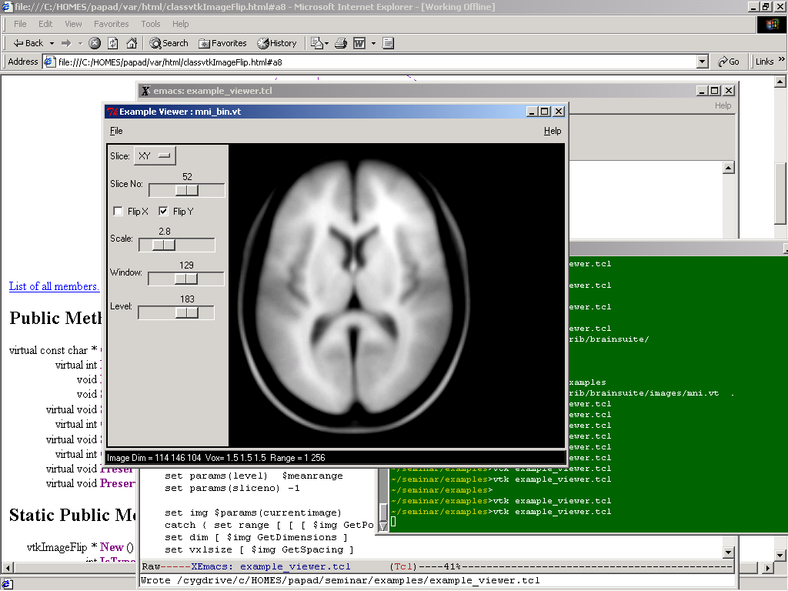
A Complete Application examples\example_viewer.tcl
(Also get MNI Resampled Brain Image: examples\mni_bin.vt)

Slide 25
The Example Viewer 2
400 Lines of Tcl Code of which 120 are comments and 70 blank lines
Tcl Constructs Used
  Graphical User Interface
    Menu, Checkbutton, OptionMenu, Scale, Label, Entry
  Global/Local Scoping
    Use of the global command
  Associative Arrays
  Standard Dialogs (FIleOpen, Message)
    tk_getOpenFile, tk_messageBox
  Modularization and Procedures

Slide 26
The Example Viewer 2
400 Lines of Tcl Code of which 120 are comments and 70 blank lines
Tcl Constructs Used
  Graphical User Interface
    Menu, Checkbutton, OptionMenu, Scale, Label, Entry
  Global/Local Scoping
    Use of the global command
  Associative Arrays
  Standard Dialogs (FIleOpen, Message)
    tk_getOpenFile, tk_messageBox
  Modularization and Procedures

Slide 27
The Example Viewer 3
VTK Objects Used
  vtkImageData – to store the images
  vtkStructuredPointsReader – to load the images
  vtkImagePermute – to reorder the voxels so as to display axial/coronal/sagittal slices
  vtkImageFlip, – to flip the images left/right, top/bottom
  vtkImageResample – to rescale the images for magnigication
  vtkImageViewer (via vtkTkImageViewerWidget) – to display the images

Slide 28
Program Structure
The program has 12 Procedures and 2 Global Variables, one of which is an associative array that is used to store the state of the application
Four procedures are used to build the Graphical User Interface, GenerateUI – main procedure which calls
    GenerateMenuUI
    BuildControlFrameUI
    CreateViewer
Three procedures are used to manage the global associate array
  params:
    InitializeParameters – called at start of program
    ResetParametersAndGUI – called when new image is loaded
    DebugParameters – prints all parameters as a debugging mechanism
Three procedures that deal with images directly
  LoadImage
  PermuteImage
  FlipScaleAndDisplayImage
An UpdateDisplay procedure to update the display
A generic utility procedure (UniqueId) to ensure unique VTK object names.

Slide 29
The Main Program
# Hide Default Tk Widget
wm withdraw .
# Create a new toplevel widget and set
# its dimensions and name
toplevel .base
wm geometry .base 600x450
# Initialize Variables
InitializeParameters
# Create The User Interface
GenerateUI .base
# Load an Image
LoadImage
# Start the Event Loop
vwait forever

Slide 30
Generating Unique Names
# -/-/-/-/-/-/-/-/-/-/-/-/-/-/-/-/-/-/-/-/-/-/-/-/
# Object Counter Code
# define proc UniqueId which returns a unique name
# each time it is called. Note the use of the global
# command to bring a global variable into
# local scope, global variables are not by default
# accessible outside the global scope
# (i.e. within a procedure)
# -/-/-/-/-/-/-/-/-/-/-/-/-/-/-/-/-/-/-/-/-/-/-/-/-/
set unique_objcounter 0
proc UniqueId { } {
global unique_objcounter
incr unique_objcounter
return "obj_${unique_objcounter}"
}
UniqueId → obj_1, call agin UniquId obj_2 etc.

Slide 31
InitializeParameters
proc InitializeParameters { } {
global params ← This makes the global variable params available I in the local scope
set params(slice) XY; set params(scale) 2.0
set params(flipx) 0 ; set params(flipy) 1
set params(window) 255; set params(level) 128
set params(sliceno) 0
set params(viewer) 0; set params(scalewidget) 0
set params(windowscalewidget) 0
set params(levelscalewidget) 0
set params(slicenoscalewidget) 0
set params(mainwidget) 0
set params(status) "No Image In Memory"
set params(currentimage) [ vtkImageData [ UniqueId ] ]
set params(currentresults) [ vtkImageData [ UniqueId ] ]
}

Slide 32
DebugParameters
# Standard Code to List an Associative Array
proc DebugParameters { } {
global params
puts stdout "\n Debugging Parameters"
puts stdout "--------------------------"
set keylist [ array names params ]
for { set k 0 } { $k < [llength $keylist] } { incr k } {
set key [lindex $keylist $k]
set value $params($key)
puts "params\($key\) = $value"
}
puts stdout "--------------------------"
}

Slide 33
The Graphical User Interface
The Menubar
The ControlFrame
The Status Widget
The Viewer

Slide 34
GenerateUI
proc GenerateUI { basewidget } {
global params
set params(mainwidget) $basewidget
wm title $params(mainwidget) "Example Viewer"
set menubar [ frame $basewidget.top ]
set viewerframe [ frame $basewidget.middle -bg black ]
entry $basewidget.status -textvariable params(status) -relief raised -state disabled -width 45 -bg black -fg white
pack $basewidget.status -side bottom -expand false -fill x -pady 1
pack $menubar -side top -expand false -fill x -pady 2
pack $viewerframe -side top -expand true -fill both -padx 2 -pady 2
frame $viewerframe.left ;
pack $viewerframe.left -side left -padx 2 -pady 2 -fill y -expand f
GenerateMenuUI $menubar
BuildControlFrameGUI $viewerframe.left
CreateViewer $viewerframe
}

Slide 35
GenerateMenuUI
proc GenerateMenuUI { menubar } {
menubutton $menubar.file -text "File" -menu $menubar.file.m menubutton $menubar.help -text "Help" -menu $menubar.help.m
pack $menubar.file -side left; pack $menubar.help -side right
set filemenu [ menu $menubar.file.m ]
$filemenu add command -label "Open" -command { LoadImage }
$filemenu add separator
$filemenu add command -label "Exit" -command { destroy .; exit }
set helpmenu [ menu $menubar.help.m ]
$helpmenu add command -label "Debug!" -command {DebugParameters}
$helpmenu add separator
$helpmenu add command -label "About!" -command {
tk_messageBox -title "About This Application" -type ok - message "Example Image Viewer\n Version 1.0\n X.Papademetris Nov 2002" }
}

Slide 36
BuildControlFrameGUI
The real strength of TK GUIs is the ability to link variables to graphical user elements i.e. checkbuttons, scales, optionmenus etc.
params(slice) -- controls what kind of slice to display
    PermuteImage ; FlipScaleAndDisplayImage
params(flipx) -- 0/1 as to whether to flip the x-axis
params(flipy) -- 0/1 as to whether to flip the y-axis
params(scale) -- expand the image by this factor
  FlipScaleAndDisplayImage
params(sliceno) -- actual slice number to display
params(window) -- sets the window width (colormap)
params(level) -- sets the window level (colormap )
  UpdateDisplay
The code is far too boring and repetive to be covered orally
see the code! Note only that :
  Changing the UI element changes the value of the linked variable
  Changing UI elements also results in the call of the appropriate event handling procedure (in yellow above).

Slide 37
CreateViewer
proc CreateViewer { viewerframe } {
global params
vtkTkImageViewerWidget $viewerframe.right -height 256 -width 256
pack $viewerframe.right -side right -expand true -fill both -pady 2
# Important ensure that the widget has been created
update
# Store viewer
set params(viewer) [ $viewerframe.right GetImageViewer ]
}

Slide 38
LoadImage
proc LoadImage { } {
global params
# Get Filename
set f [tk_getOpenFile -title "Load Image" -filetypes { {"VTK Image Format" {.vt}}} ]
if { [ string length $f ] < 1 } { return 0}
# Load Image
set reader [ vtkStructuredPointsReader [ UniqueId ]]
$reader SetFileName $f; $reader Update
$params(currentimage) ShallowCopy [ $reader GetOutput ]
$reader Delete
# Set Application Title
wm title $params(mainwidget) "Example Viewer : [ file tail $f ]“
# Process Image
ResetParametersAndGUI
PermuteImage
FlipScaleAndDisplayImage
}

Slide 39
ResetParametersAndGUI
proc ResetParametersAndGUI { } {
global params
# Default View
set params(slice) XY ; set params(flipx) 0; set params(flipy) 1
set params(scale) 2.0
# Get Intensity Range and Reset Colormap and GUI Ranges
set range [ [ [ $params(currentimage) GetPointData ] GetScalars ] GetRange ]
set meanrange [ expr 0.5*([ lindex $range 0 ] + [ lindex $range 1 ])]
set fullrange [ expr [ lindex $range 1 ] - [ lindex $range 0 ]]
$params(windowscalewidget) configure -from 0 -to $fullrange
$params(levelscalewidget) configure -from [ lindex $range 0 ] -to [ lindex $range 1 ]
set params(window) $meanrange; set params(level) $meanrange
# Set The Status Bar To reflect new image
set img $params(currentimage); set dim [ $img GetDimensions ]
set vxlsize [ $img GetSpacing ]
set params(status) "Image Dim = $dim Vox= $vxlsize Range = $range"
}

Slide 40
PermuteImage
proc PermuteImage { } {
global params
set perm [ vtkImagePermute [ UniqueId ]]
$perm SetInput $params(currentimage)
# Set The Axis to Map to X-Y-Z e.g. 0 2 1 X->X Z->Y Y->Z
switch $params(slice) {
"XY" { $perm SetFilteredAxes 0 1 2 }
"YX" { $perm SetFilteredAxes 1 0 2 }
"XZ" { $perm SetFilteredAxes 0 2 1 }
"ZX" { $perm SetFilteredAxes 2 0 1 }
"YZ" { $perm SetFilteredAxes 1 2 0 }
"ZY" { $perm SetFilteredAxes 2 1 0 }
}
$perm Update
$params(currentresults) ShallowCopy [ $perm GetOutput ]
$perm Delete
# Get Number of Slices for this orientation and update GUI
set numslices [ lindex [ $params(currentresults) GetDimensions ] 2 ]
$params(slicenoscalewidget) configure -from 0 -to [ expr $numslices -1 ]
set params(sliceno) [ expr $numslices/2 ]
}

Slide 41
FlipScaleAndDisplayImage
proc FlipScaleAndDisplayImage { } {
global params
# Three Filter Pipeline , flipx,flipy,scale
set tmp [ vtkImageData [ UniqueId ] ]
$tmp ShallowCopy $params(currentresults)
if { $params(flipx) == 1 } {
set fx [ vtkImageFlip [ UniqueId ]]
$fx SetInput $tmp; $fx SetFilteredAxis 0; $fx Update
$tmp ShallowCopy [ $fx GetOutput ]; $fx Delete
}
.. Same fory axis
if { $params(flipy) == 1 } { … $fy SetFilteredAxis 1 …}
set imageResample [ vtkImageResample [ UniqueId ]]
$imageResample SetInput $tmp; $imageResample InterpolateOn
$imageResample SetAxisMagnificationFactor 0 $params(scale)
$imageResample SetAxisMagnificationFactor 1 $params(scale)
$imageResample SetAxisMagnificationFactor 2 1.0
$params(viewer) SetInput [ $imageResample GetOutput ]
$imageResample Delete; $tmp Delete
UpdateDisplay
}

Slide 42
UpdateDisplay
proc UpdateDisplay { } {
global params
# round() ensures integer output
$params(viewer) SetZSlice [ expr round($params(sliceno))]
$params(viewer) SetColorLevel $params(level)
$params(viewer) SetColorWindow $params(window)
$params(viewer) Render
}

